Slide 1
Management of Asthma and Bronchiolitis

Slide 2
Asthma
Is an inflammatory condition that leads to tightening of the muscles around the airways and swelling that cause airways to narrow and produce extra mucus.

Slide 3
3 types of Asthma
Nocturnal asthma
Exercise induced asthma/ exercise induced bronchoconstriction
Allergic asthma / seasonal asthma

Slide 4
What triggers asthma
Sinus infections
Allergies
Pollen
Breathing in some chemicals
Acid reflux
Physical exercise
Bad weather ( thunderstorms/ high humidity breathing in cold or dry air)
Breathing in fragrances
Some food or food additives (sulfites)

Slide 5
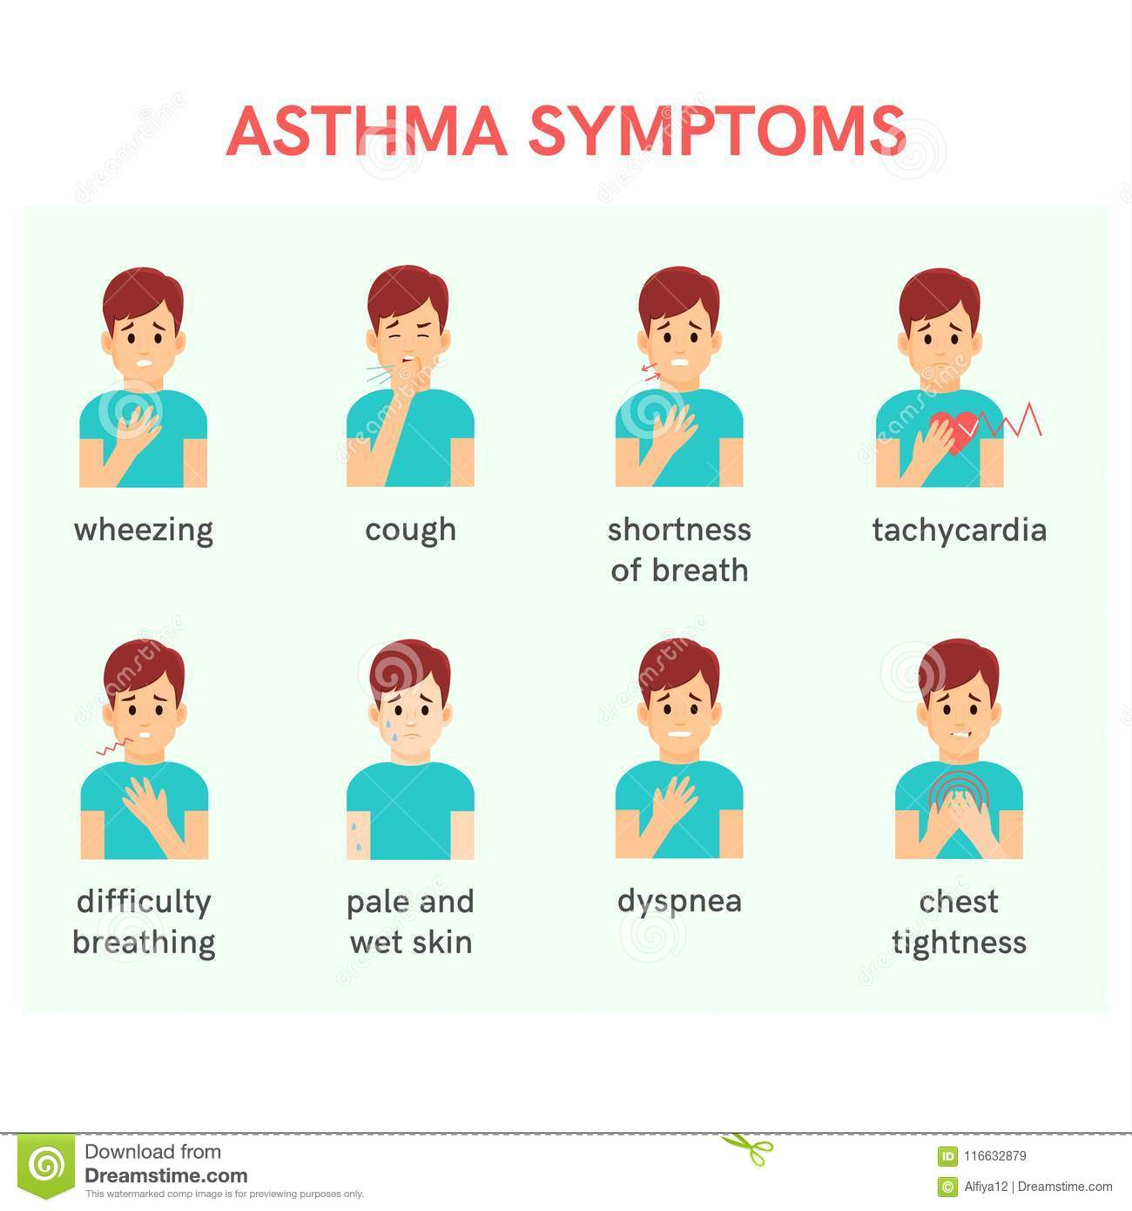
Signs and symptoms:

Slide 6
HOW IS ASTHMA DIAGNOSED?
PHYSICAL EXAM-based on signs and symptoms and health problems (3main symptoms; cough,wheeze,sob)
Pulmonary(lung function test)-bronchodilator is given before these tests;
SPIROMETRY-measure the amount/speed of air that can be inhaled and exhaled(determines the narrowing of bronchial tubes)
PEAK FLOW METERS-used to measure the peak expiratory flow rate w/c is important in both monitoring and diagnosing asthma

Slide 7
IMAGING TEST- CT SCAN , CHEST XRAY to identify the structural abnormalities or disease
METHACHOLINE CHALLENGE TEST-methacholine is known as asthma trigger,if you reacts to methacholine you are most likely have asthma.
SPUTUM EOSINOPHILS- presence of eosinophils in saliva/ sputum you discharge during coughing
NITRIC OXIDE TEST-also known as the fractional exhaled nitric oxide used to measure the amount of gas(nitric oxide) in an exhaled sample of your breath
ALLERGY TESTING- skin or blood test

Slide 8
Two main medications used to treat asthma
Long term control medications-(inhaled corticosteroids,leukotriene receptor antagonists,long acting beta agonist,theophylline)
Quick relief medications-oral and iv corticosteroids,atrovent,short acting beta agonist.
FOR PATIENTS WITH AN ACUTE ASTHMA EXACERBATION THAT HAS NOT RESPONDED TO FIRST LINE THERAPY (BRONCHODILATORS AND CORTICOSTEROIDS) CAN BE TREATED EFFECTIVELY WITH IV MAGNESIUM SULPHATE.

Slide 9
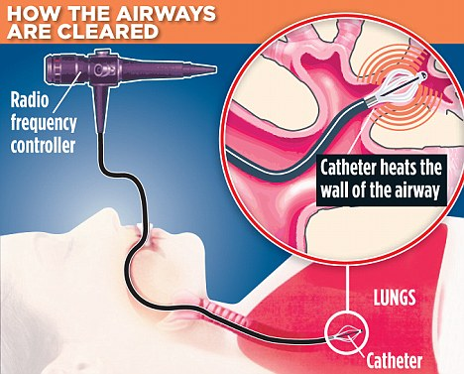
BRONCHIAL THERMOPLASTY

Slide 10
How to prevent / minimize asthma attacks
Follow your asthma action plan
Get vaccinated for influenza and pneumonia
Identify and avoid asthma triggers
Monitor your breathing
Identify and treat attacks early
Take your medication as prescribed
Pay attention to increasing quick relief inhaler use.

Slide 11
Bronchiolotis
Is a common lung infection in young children and infants. It causes inflammation and congestion in the small airways (bronchioles) of the lung. It is almost always caused by a virus and its peak time is during winter months.

Slide 12
CAUSES:
ADENOVIRUS
RHINOVIRUS
PARAINFLUENZA VIRUS
RESPIRATORY SYNCYTIAL VIRUS

Slide 13
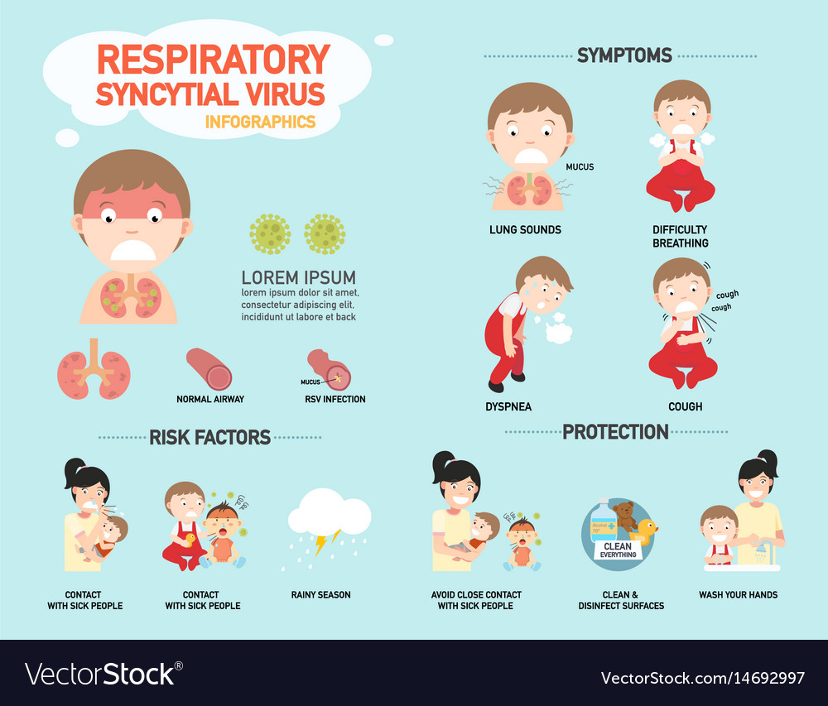
RSV(RESPIRATORY SYNCYTIAL VIRUS- the common causative virus in bronchiolitis

Slide 14
Signs and Symptoms
Runny nose
Stuffy nose
Cough
Slight fever
Ear infection
Wheezing

Slide 15
Risk Factors
Age under 2 years
Premature birth
Underlying heart or lung condition
Depressed immune system
Exposure to tobacco smoke
Never having been breast fed
Contact with multiple children
Spending time in crowded places

Slide 16
When to seek medical attention?
Audible wheezing sounds
Tachypnea
Labored breathing
Sluggish or lethargic appearance
Refusal to drink enough
Skin turning blue especially lips or fingertips

Slide 17
Complications of severe bronchiolitis
Blue lips / skin
Pauses in breathing (apnea)
Dehydration
Low oxygen levels and respiratory failure
Secondary bacterial infection

Slide 18
DIFFERENTIAL DIAGNOSIS:
ACUTE ASTHMA
VIRAL INDUCED –WHEEZE
PNEUMONIA
CONGESTIVE HEART FAILURE
PERTUSSIS

Slide 19
Management for Bronchiolitis:
HYDRATION-ENCOURAGE ORAL INTAKE/ NGT FEEDING/INTRAVENOUS FLUIDS
O2 SUPPLEMENT/ OXYGENATION- HFNC ,NIV (CPAP/BIPAP, INTUBATION)
SALINE NASAL DROPS
ORO-NASAL SUCTION
*LITTLE EVIDENCE FOR
B RONCHODILATORS,STEROIDS,ANTIBIOTICS,NEBULISED SALINE

Slide 20
How to prevent bronchiolitis
Limits contact with people who have fever and colds
Clean and disinfect surfaces
Observe proper respiratory hygiene
Use your own drinking glass
Wash hands often
Breast feed

Slide 21
Thank you!

